Slide 1
Advance SQL
Instructor: Kazi Amit Hasan

Slide 2
Group By/Aggregate Function
The GROUP BY statement is used to group rows that have the same values
The GROUP BY statement is almost always used in conjunction with aggregate functions,
like COUNT(),
MAX(), MIN(),
SUM(), AVG(), to perform calculations on each group.

Slide 3
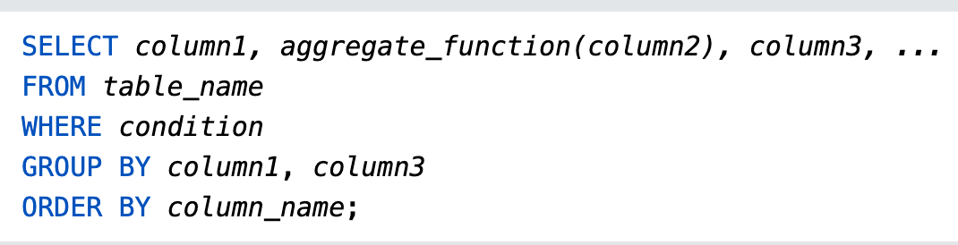
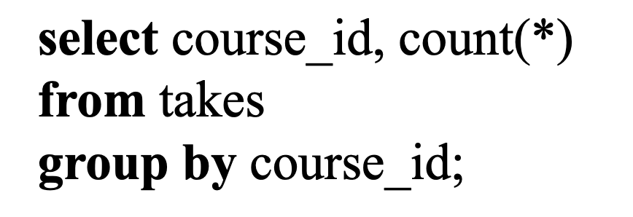
Group By/Aggregate Function
Find the number of students who took each course (course_id)

Slide 4
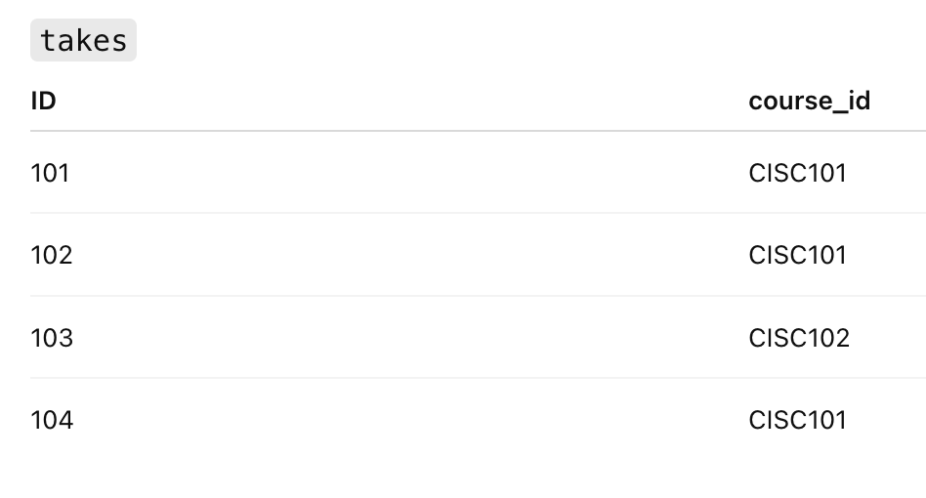
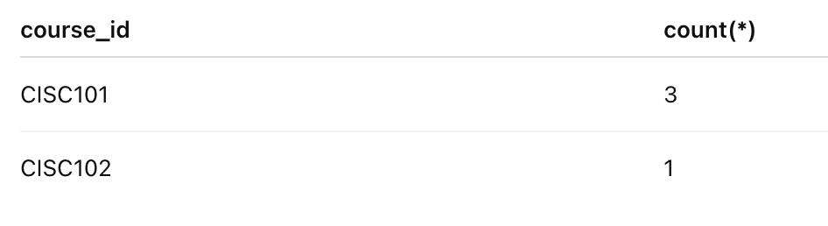
Group By/Aggregate Function
Find the number of students who took each course (course_id)

Slide 5
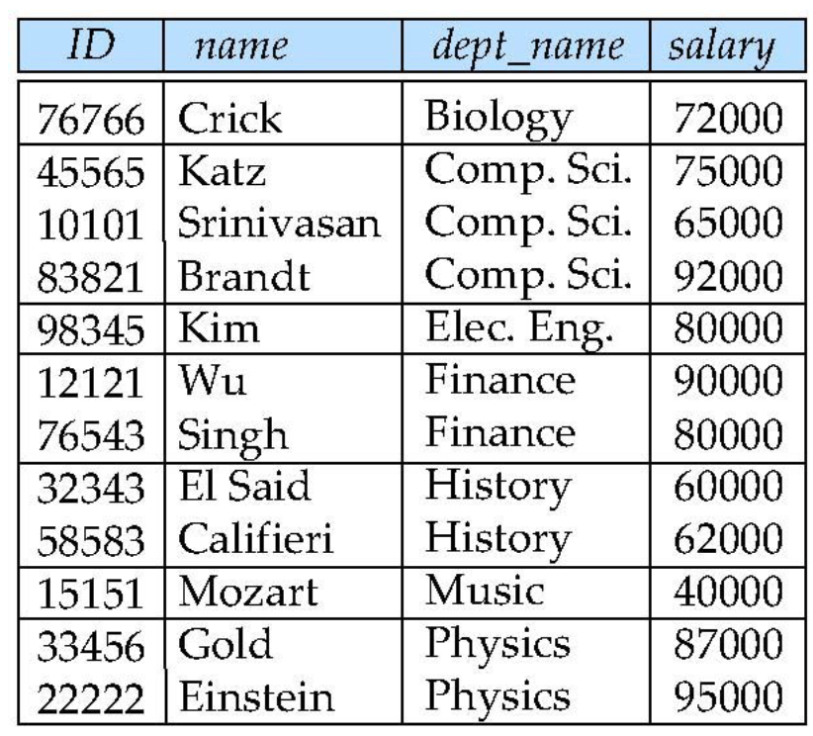
Aggregate Functions – Group By
Find the average salary of instructors in each department

Slide 6
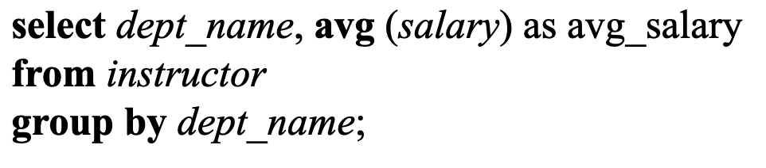
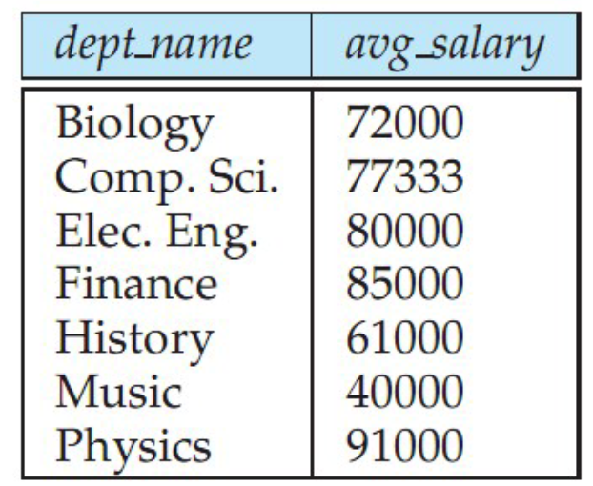
Find the average salary of instructors in each department

Slide 7
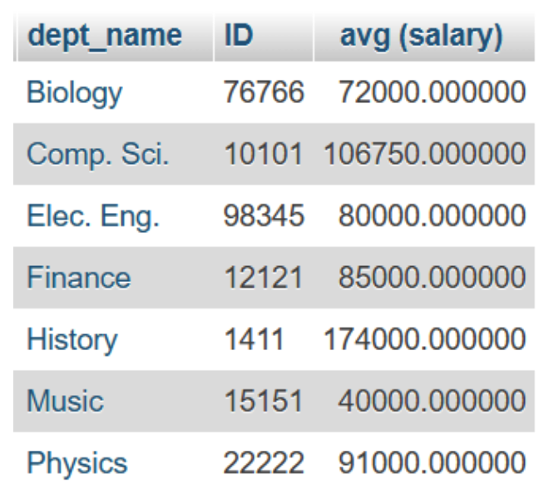
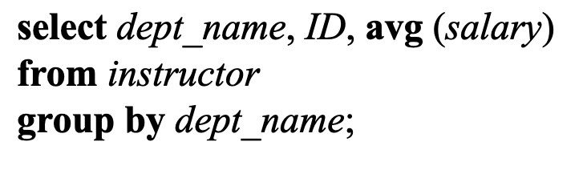
Important
Attributes in select clause outside of aggregate functions must appear in group by list

Slide 8
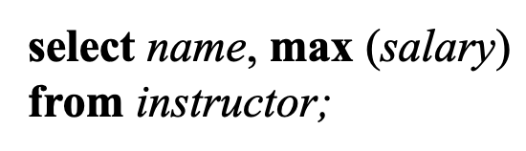
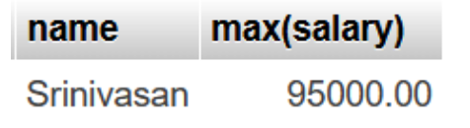
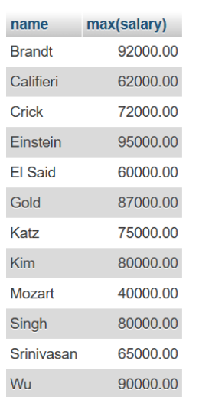
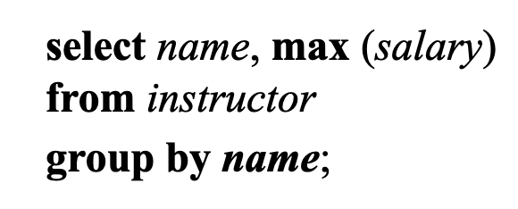
Important
Find the name of the instructor making the most money

Slide 9
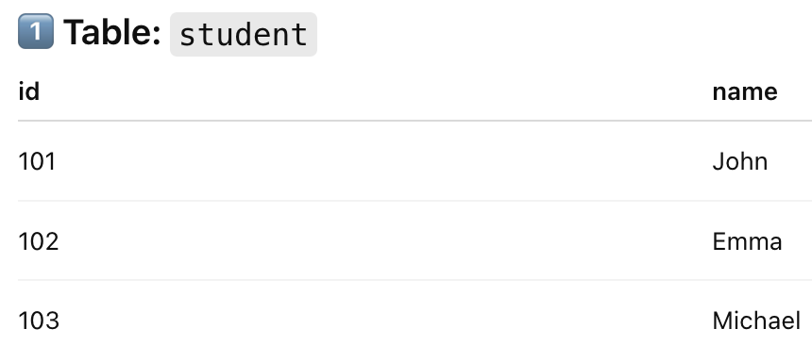
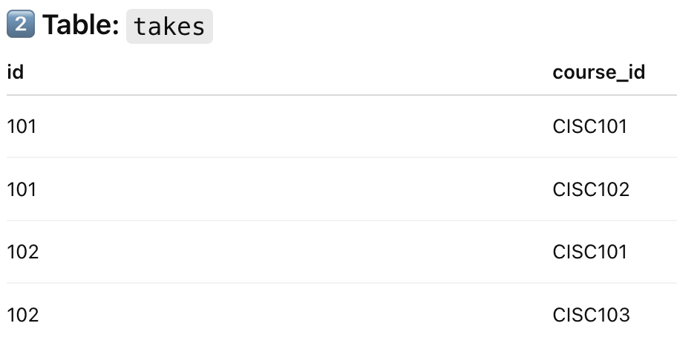
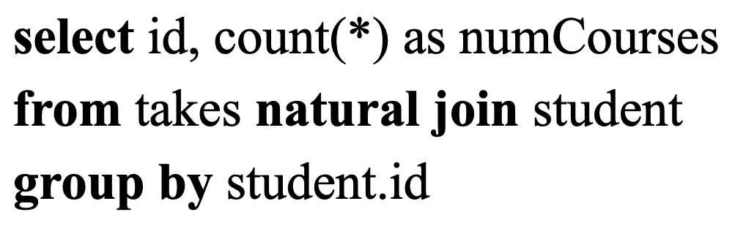
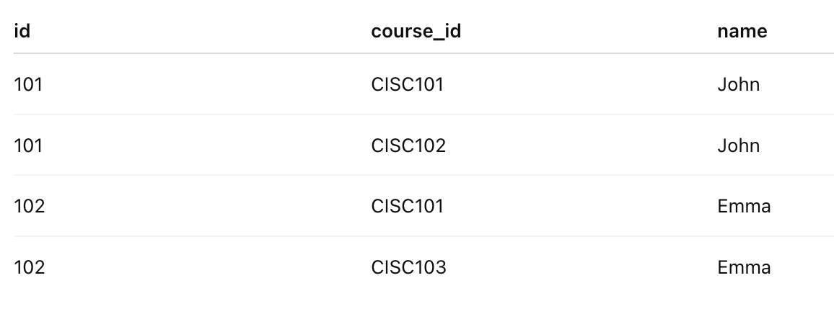
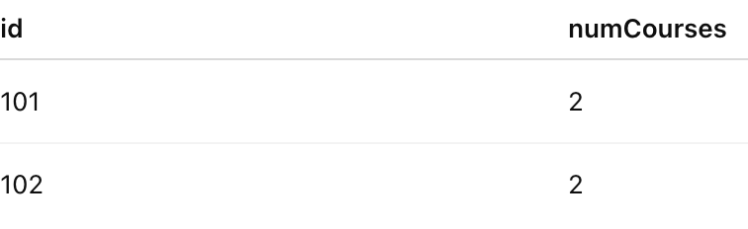
List all students’ id as well as the total number of courses they have taken

Slide 10
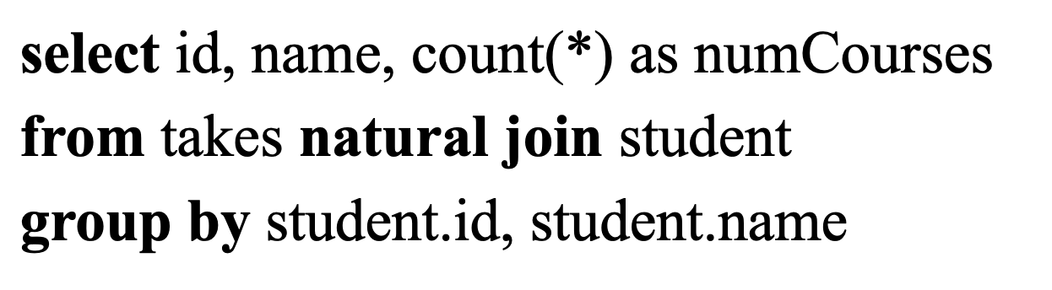
List all students’ id and name as well as the total number of courses they have taken.

Slide 11
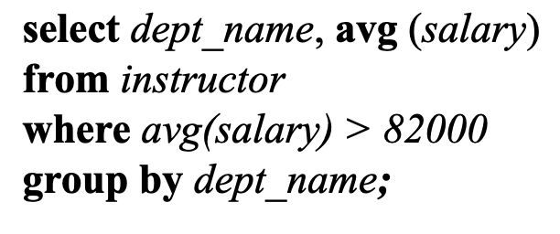
Aggregate Functions – Incorrect Example
Find the names and average salaries of all departments whose average salary is greater than 82000
Aggregate Functions DO NOT belong in the where clause
Also, the where clause is applied before the aggregation in the select clause

Slide 12
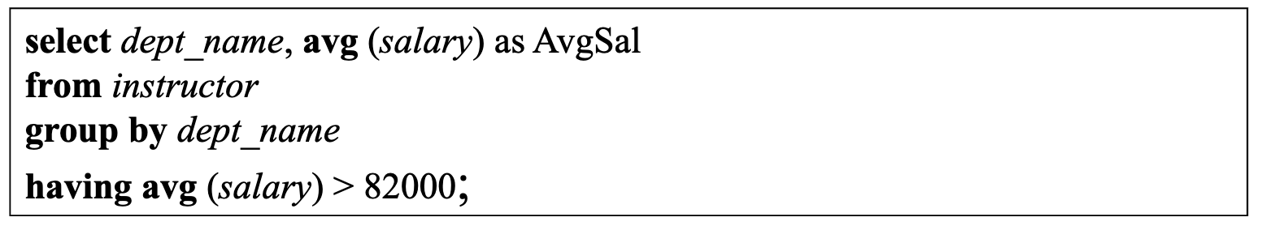
Aggregate Functions – Having Clause
Find the names and average salaries of all departments whose average salary is greater than 82000
The having clause is applied to groups not to individual tuples

Slide 13
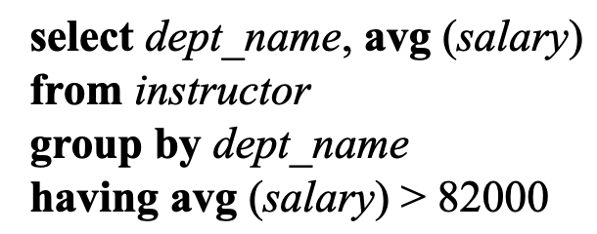
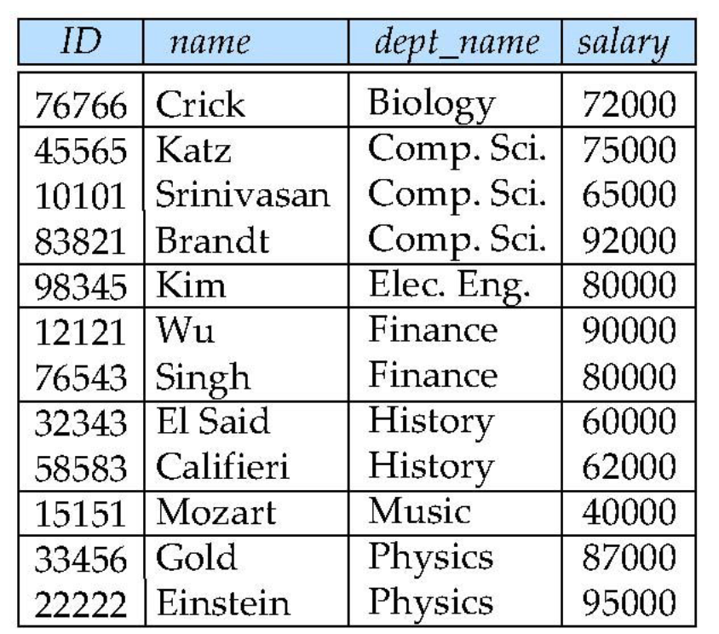
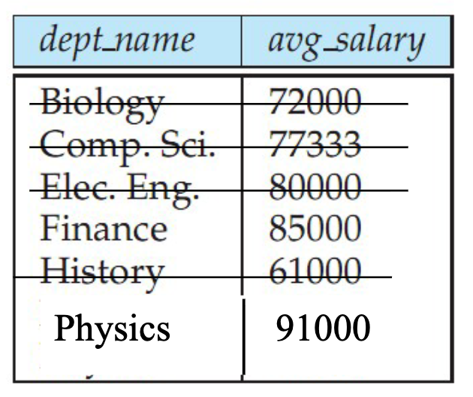

Slide 14
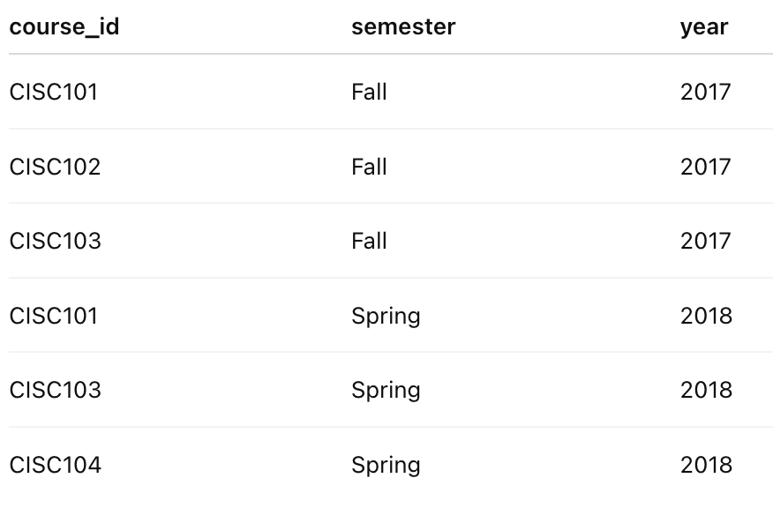
Nested Queries
Find courses offered in both Fall 2017 and in Spring 2018. (Not either/or, they must be offered in both terms)

Slide 15
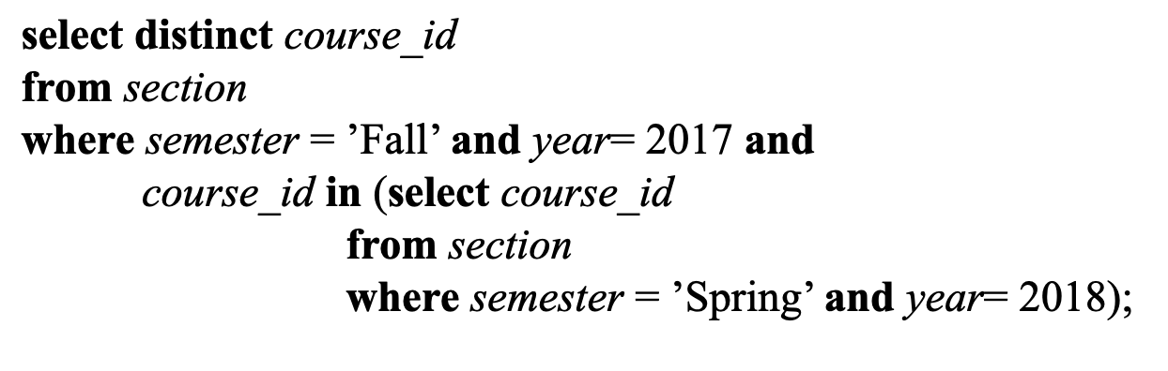
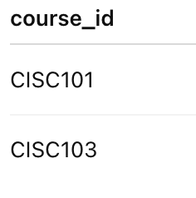
Find courses offered in both Fall 2017 and in Spring 2018. (Not either/or, they must be offered in both terms)
What relational algebra operator does this correspond to?

Slide 16
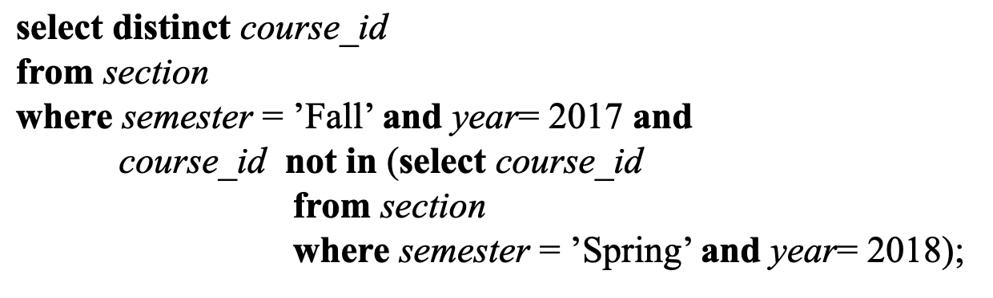
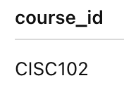
Find courses offered in Fall 2017 but not in Spring 2018
What relational algebra operator does this correspond to?

Slide 17
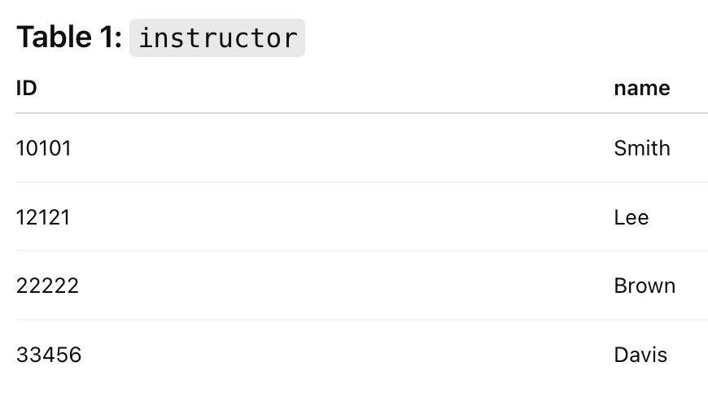
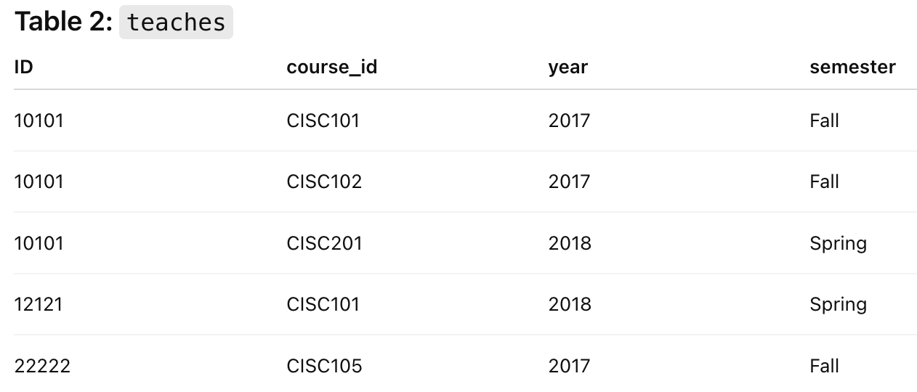
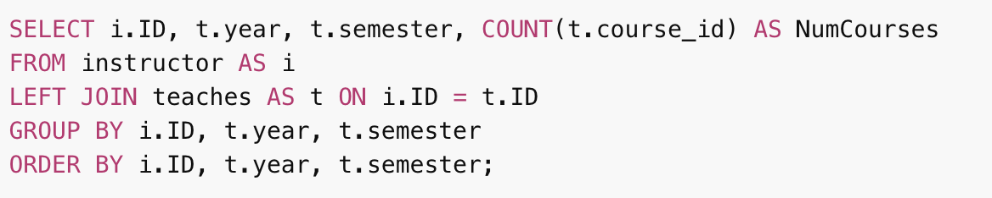
Write a query that shows how many courses each professor taught in each year and each semester. Include professors who taught no courses. Your table should have 4 columns: ID, Year, Semester, NumCourses

Slide 18
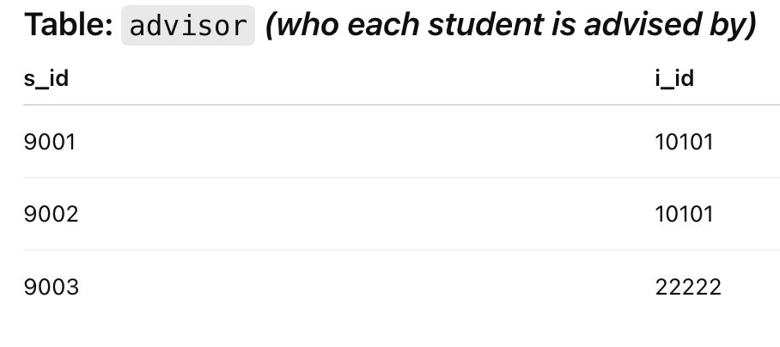
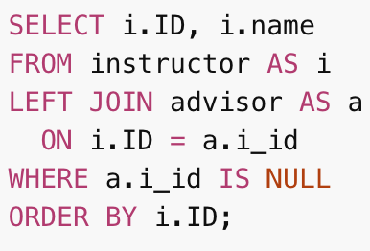
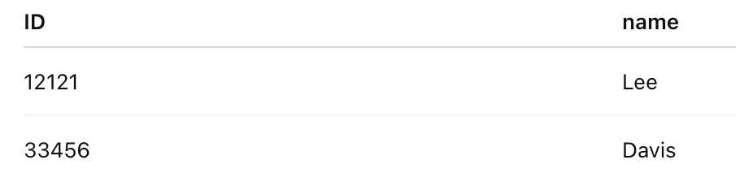
Write a query that lists the ID and names of all professors who are not advising any students.

